Slide 1
MACHINE LEARNING BASED DIABETES CLASSIFICATION AND PREDICTION
Team Members:
Mittapelly Akhila(2203A51119)
Bongu Preethika(2203A51106)
Guide:
Mr. L. Gunakar Rao

Slide 2
Agenda
Project Definition & Objectives
Introduction
Literature Review
Progress on Implementation
Methodology & Proposed Approach
Result/Outputs Achieved So Far
Project Planning And Timeline
Team Collaboration & Presentation
Conclusion

Slide 3
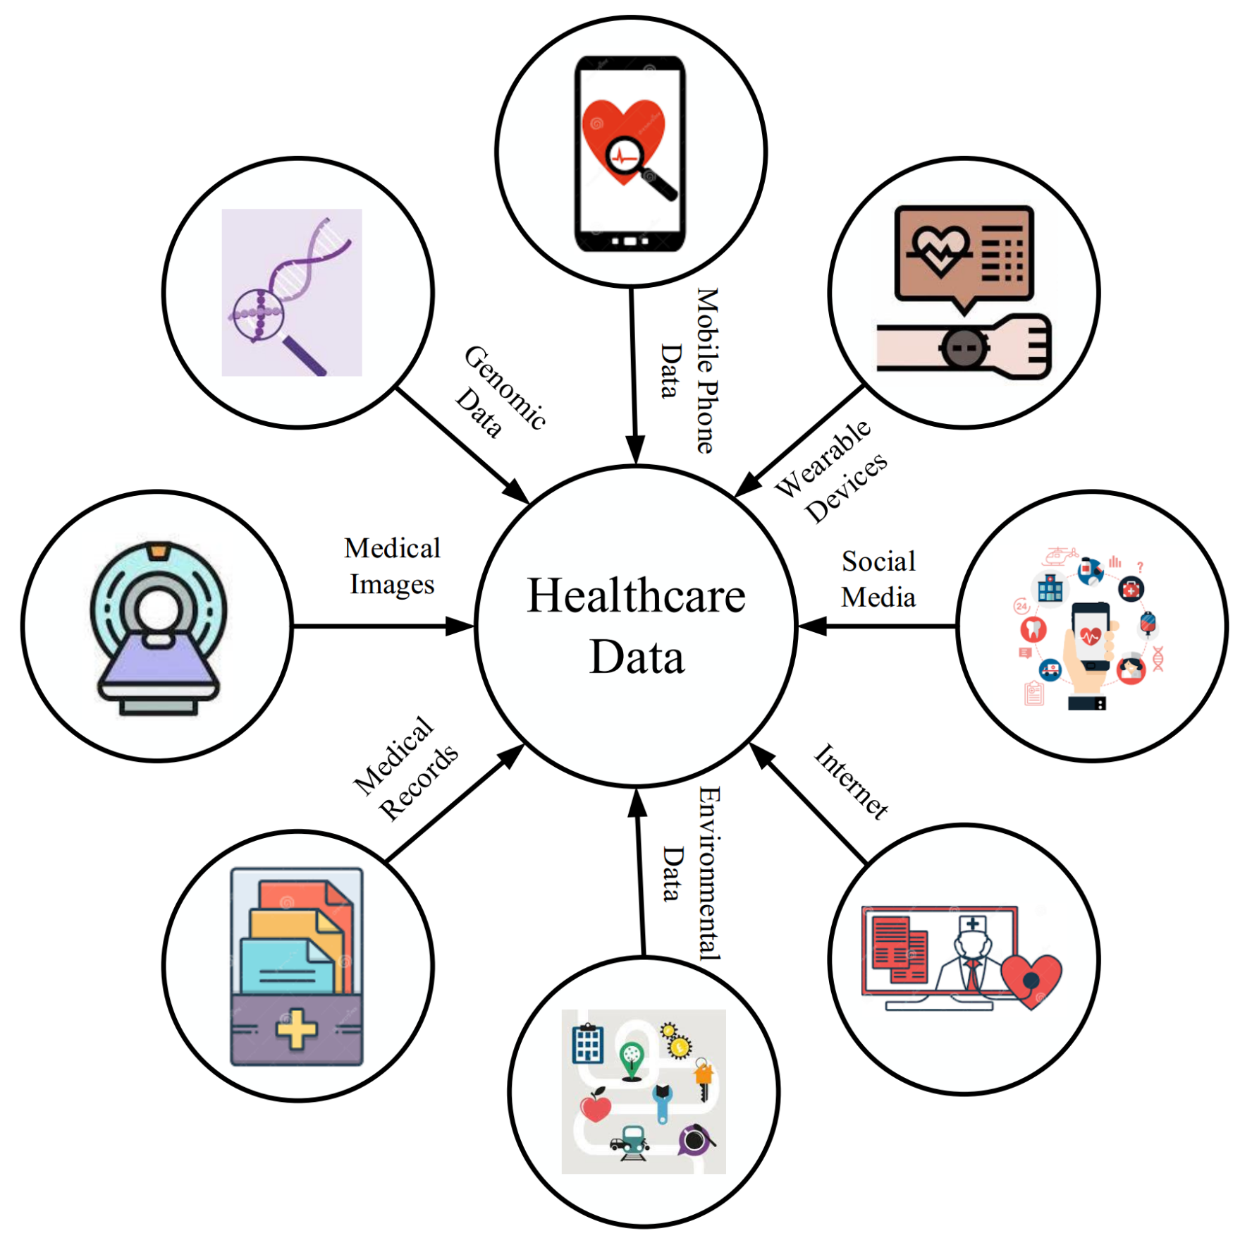
Project Definition & Objectives
Developing a diabetes prediction system using Machine Learning?
Uses patient information such as glucose, BMI, insulin levels and age.e ).
Provides classification: diabetic or non-diabetic.
Model Accuracy:
Random Forest: ~80% – 85%
XGBoost: ~85% – 90% (Best Performance)
Predict diabetes using input features.
Use PIMA Indian Diabetes Dataset.
Which ML algorithms can be employed with XGBoost (or Random Forest) software?

Slide 4

Introduction
Diabetes is a chronic disease affecting blood sugar levels
Causes: lack of insulin or insulin resistance
Leads to complications like heart disease, kidney failure
Early detection is important to prevent risks

Slide 5
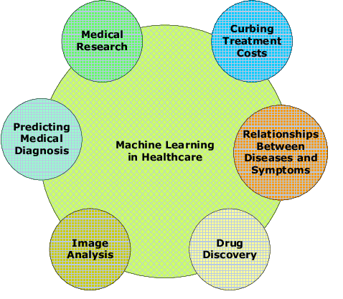
Literature Review
ML was used in several studies to predict the development of diabetes.The study findings were overwhelming.
The algorithms utilized are Decision Tree, SVM and Random Forest.
According to recent research, XGBoost is known to enhance performance.’
Feature selection improves prediction accuracy.

Slide 6
Progress on Implementation
Dataset collected from medical records.
Data preprocessing completed.
Feature selection applied.
Models implemented: Random Forest, XGBoost, LightGBM.
Technologies Used
Python
Libraries: NumPy, Pandas, Scikit-learn
Framework: Django
Frontend: HTML
Tools: Jupyter Notebook / VS Code

Slide 7
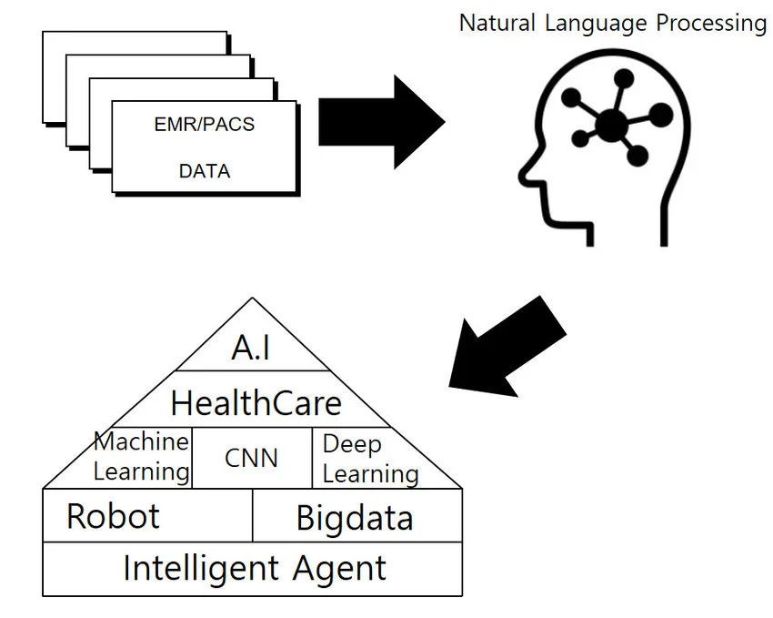
Methodology & Proposed Approach
Analyze the factors that are taken into account, such as age, BMI, and insulin levels.
Data collection and preprocessing.
Algorithm selection and comparison.
Model implementation.
Performance evaluation using metrics.

Slide 8
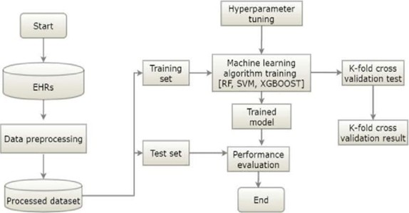
System Architecture
User enters health data
System processes data
ML model predicts result
Output displayed to user
Admin manages dataset and training
The diagram outlines a machine learning workflow using EHR data. It involves data preprocessing, splitting into training and test sets, hyperparameter tuning, training models (RF, SVM, XGBoost), performing K-fold cross-validation, and evaluating model performance to finalize the process.

Slide 9
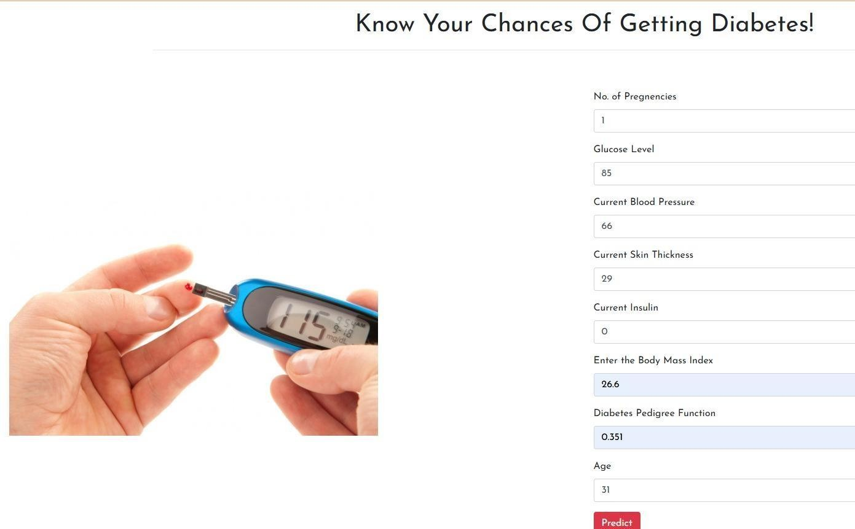
Results / Outputs

Slide 10

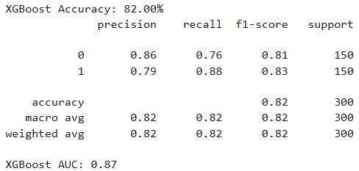
Output:
Models evaluated using:
Accuracy
Precision
Recall
F1-score
XGBoost achieved high accuracy
System predicts diabetes based on user input
Among all the models, XGBoost demonstrated the highest accuracy and overall performance due to its advanced boosting technique, which enhances prediction capability and reduces errors. Random Forest also showed strong performance with good generalization and lower chances of overfitting.

Slide 11
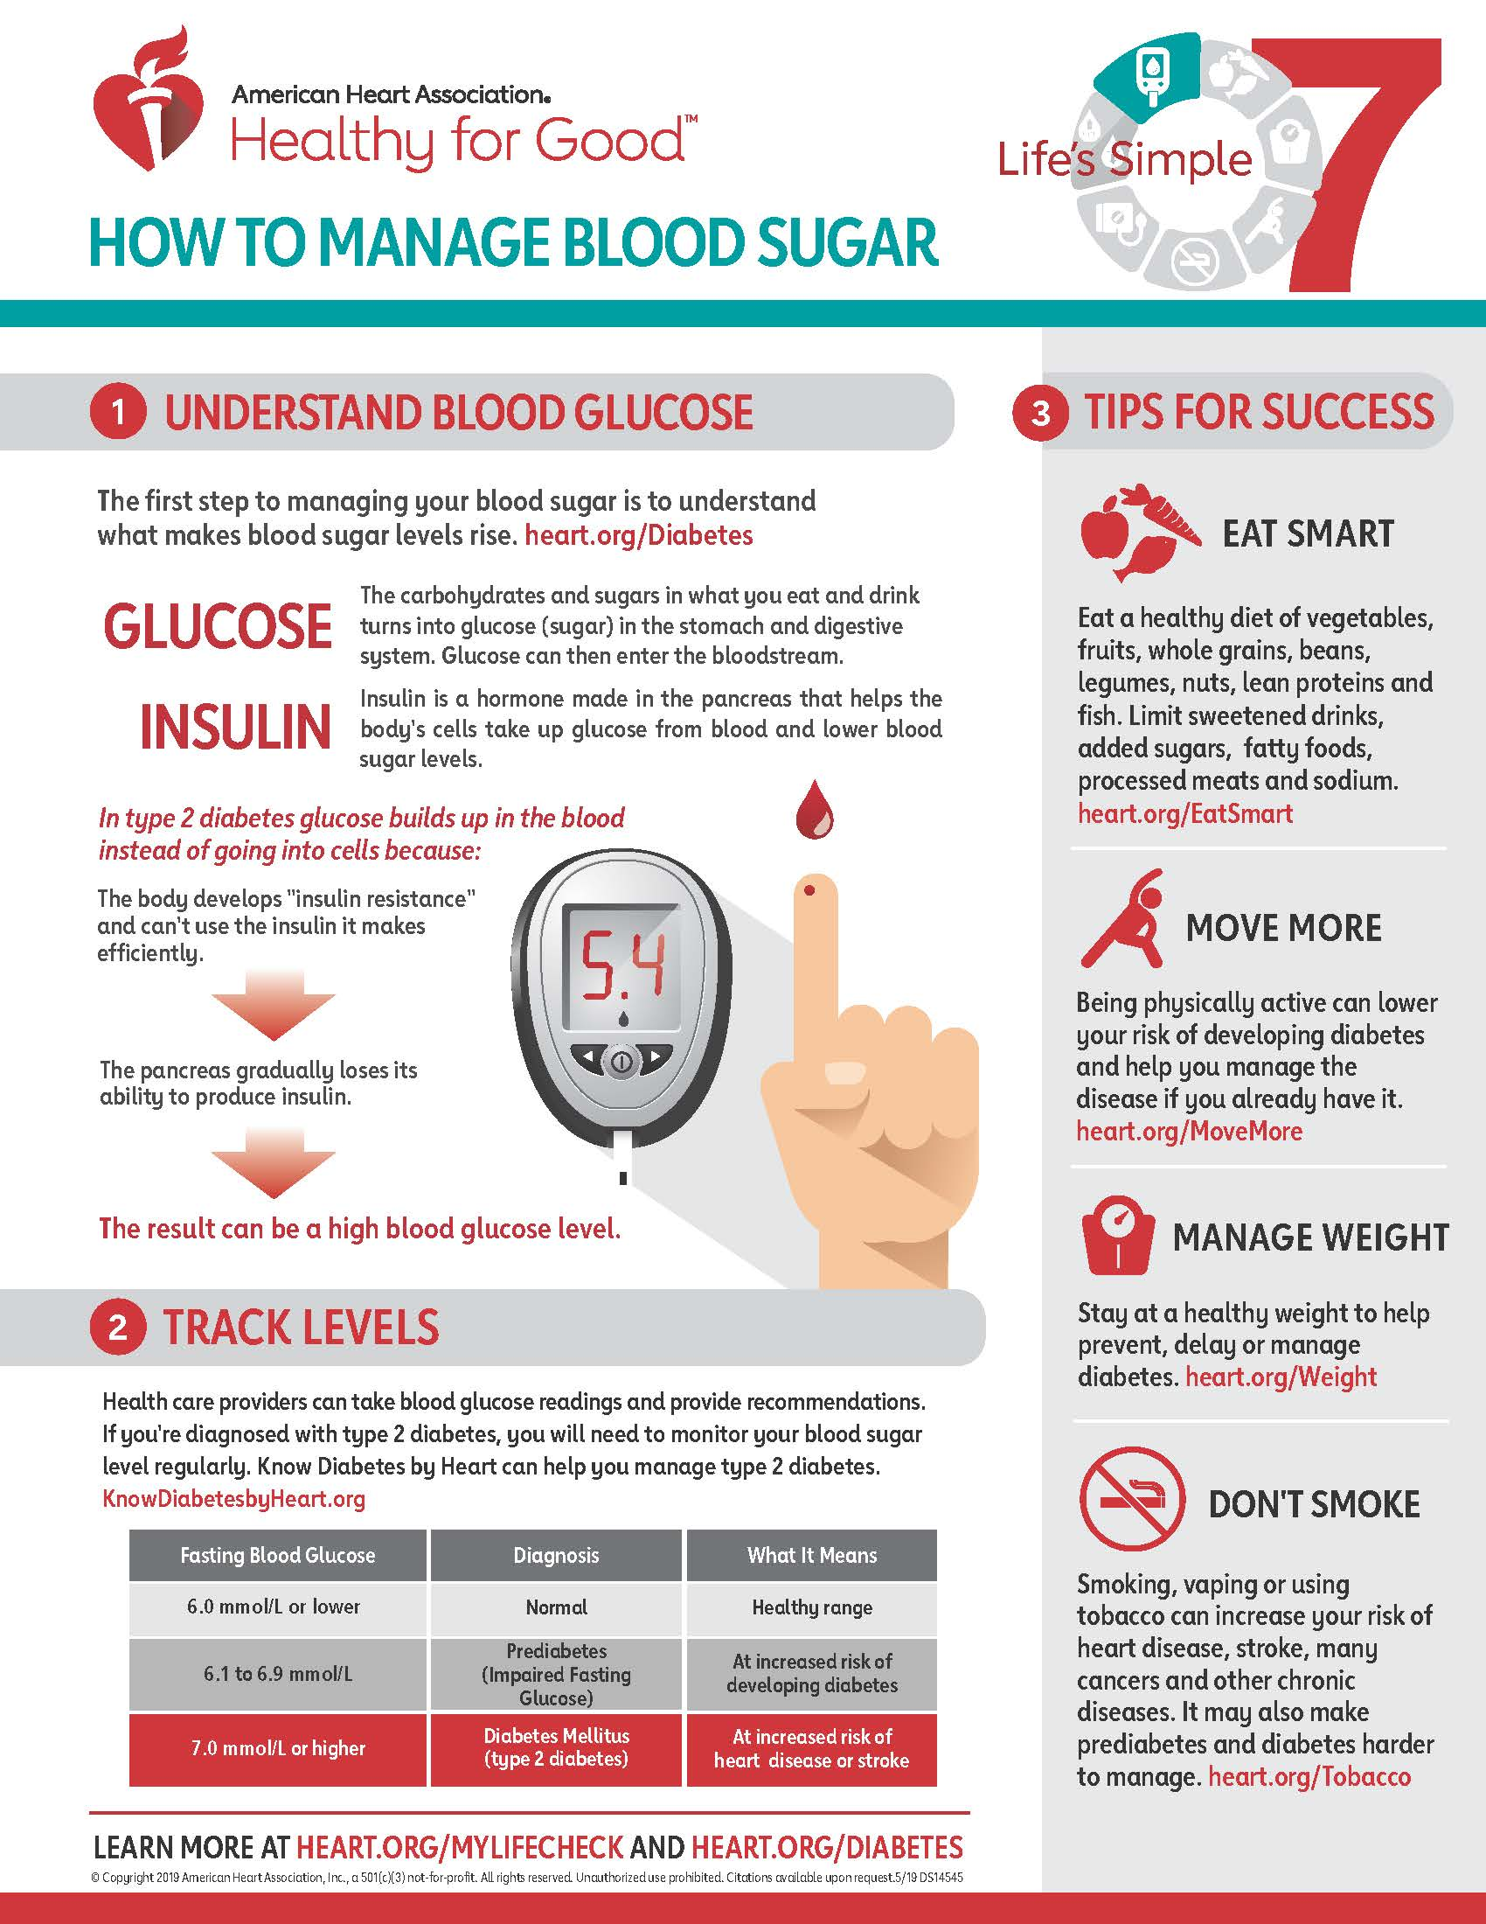
Conclusion
These technological advances can lead to better health outcomes through early detection and personalized treatment.
ML models are effective for diabetes prediction
XGBoost provides high accuracy
Random Forest reduces overfitting
System can be improved using real-time data
Future Scope
Integration with real-time health data
Cloud-based deployment
Use of wearable devices
Improve accuracy with advanced models

Slide 12
Thank you
Team Members:
Mittapelly Akhila(2203A51119)
Bongu Preethika(2203A51106)
Guide:
Mr. L. Gunakar Rao

